Slide 1
MBA Department Events Even Semester January – February 2020

Slide 2
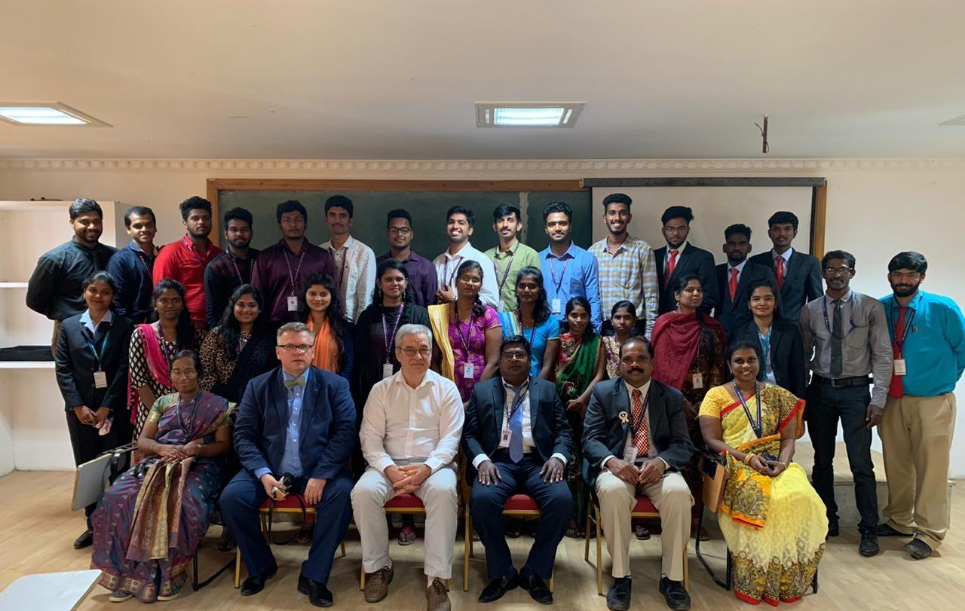
A Seminar on “Design Thinking and Gamification” by Prof Alexey Kluyev, Director-School of Public Administration & Prof. Alexander Lashin, Deputy Director – Academic Affairs, Ural Federal University, Russia on 17 & 18.12.2019

Slide 3
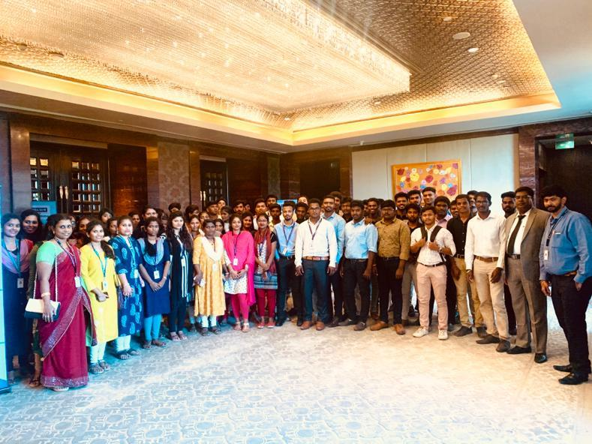
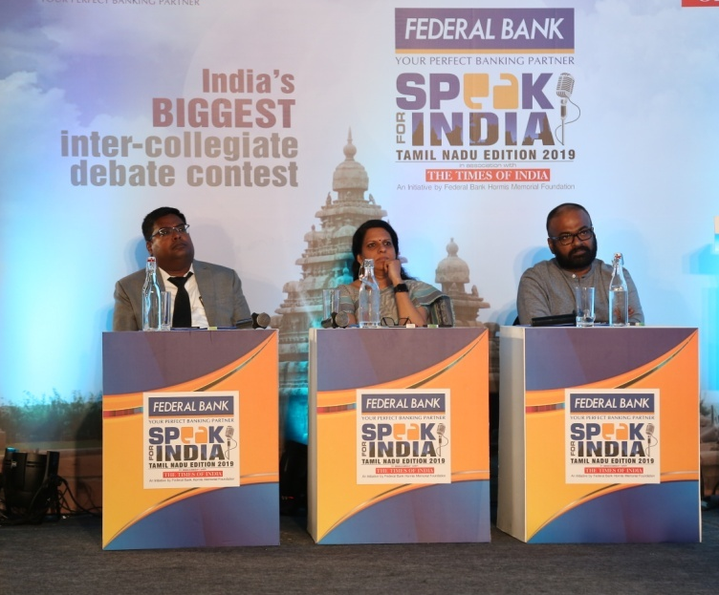
Staff & Students of DoMS at “Speak for India” at ITC Grand Chola, on 23.01.2020

Slide 4
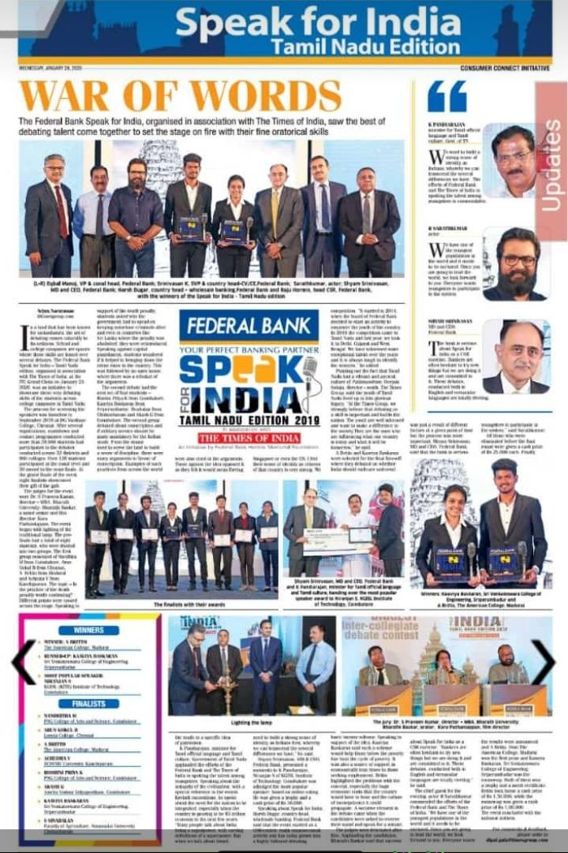
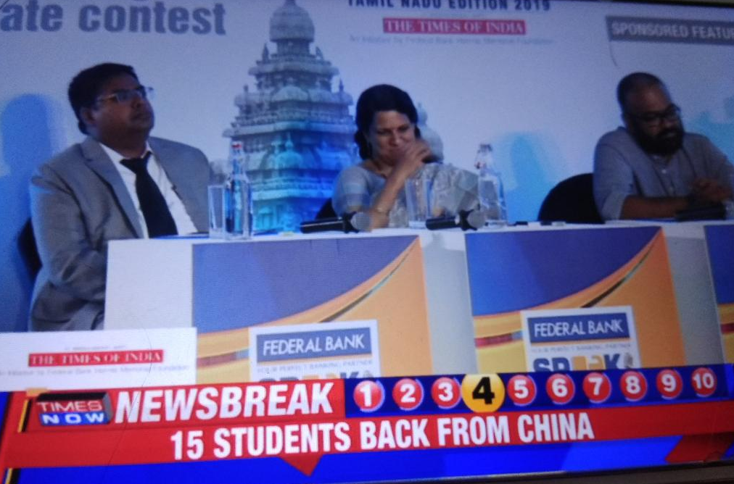
In the Media – TOI & Times Now

Slide 5
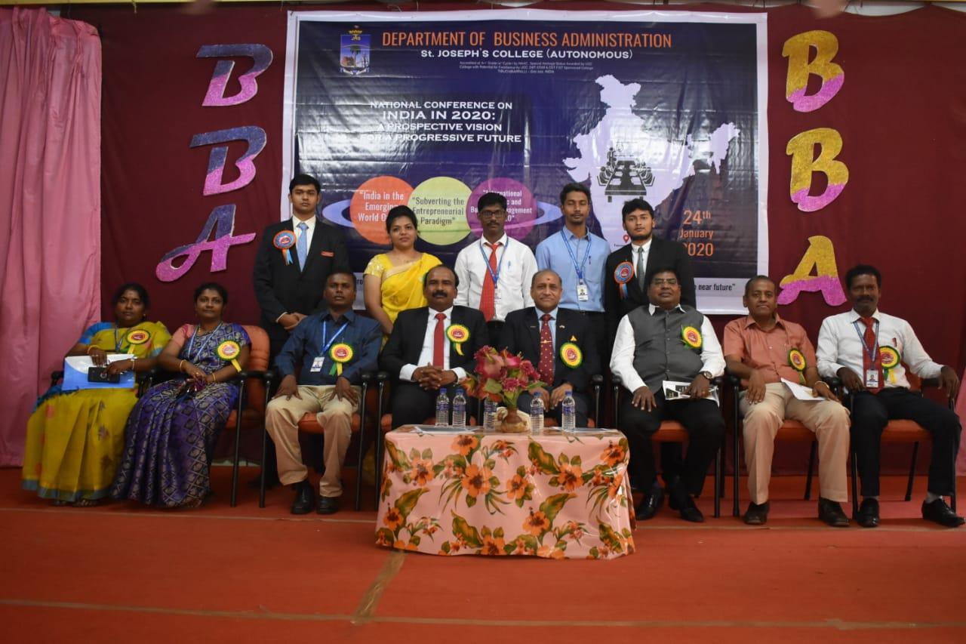
Resource Person for a Technical Session in the National Conference on “India in 2020” at St.Joseph’s College, Trichy on 24.01.2020

Slide 6
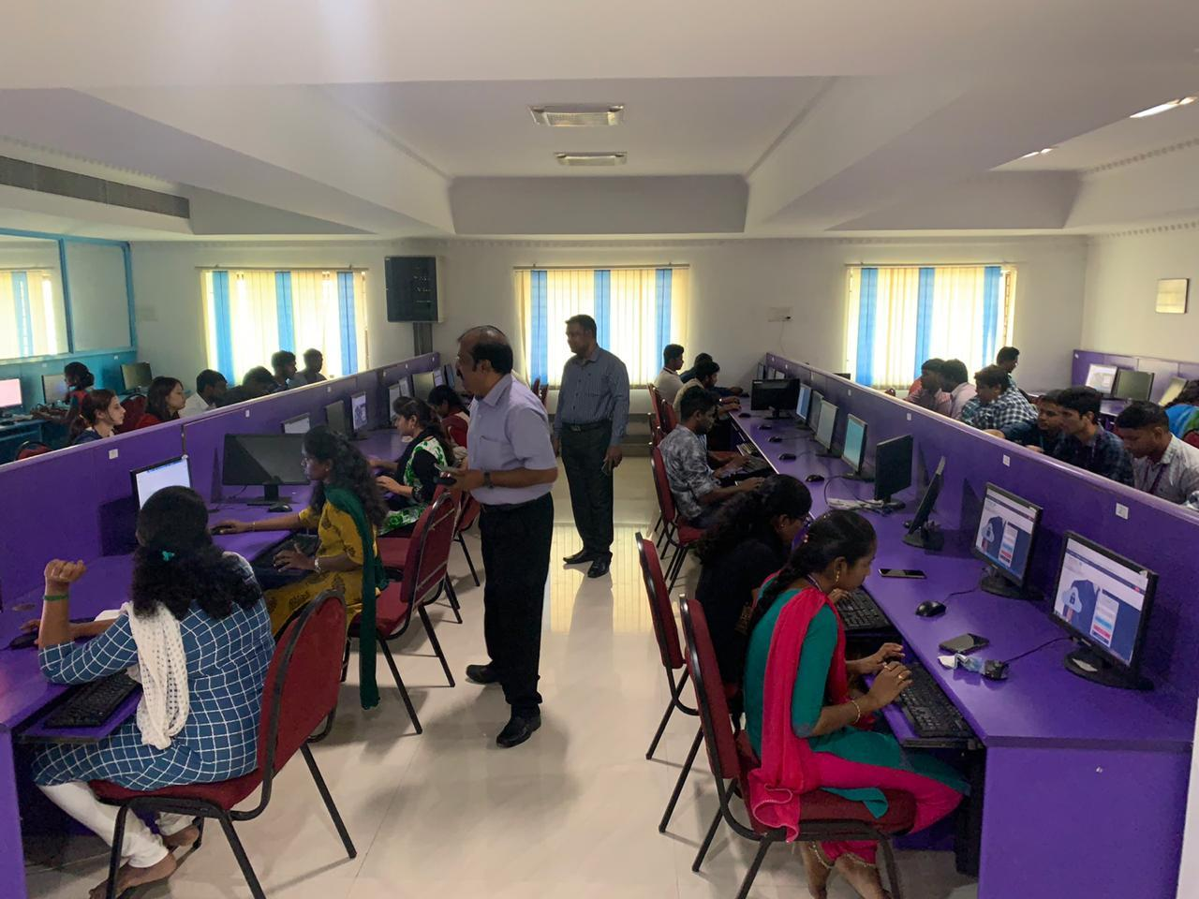
Business Standard’s “B School Digital Test” in the presence of Mr S Jayaram, Regional-Head, Market Development, Business Standard on 28.01.2020

Slide 7
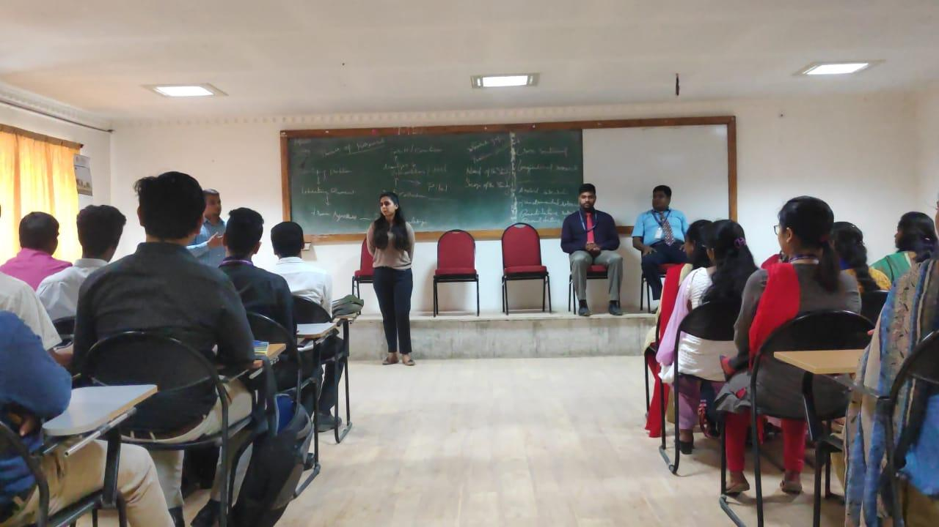
A Guest Lecture on “Campus to Corporate” by the HR Team from Capgemini on 22.01.2020

Slide 8
Pongal Celebration in the Department, 10.01.2020

Slide 9
Road Safety Awareness covering 7 States

Slide 10
International Advisory Committee Member in ICRCET, International Conference in Singapore 30 & 31 Jan 2020

Slide 11
Advisory Board Member in Udhyog, a Job Portal Company

Slide 12
Intra - Department Case Study Competition, 11.01.2020

Slide 13
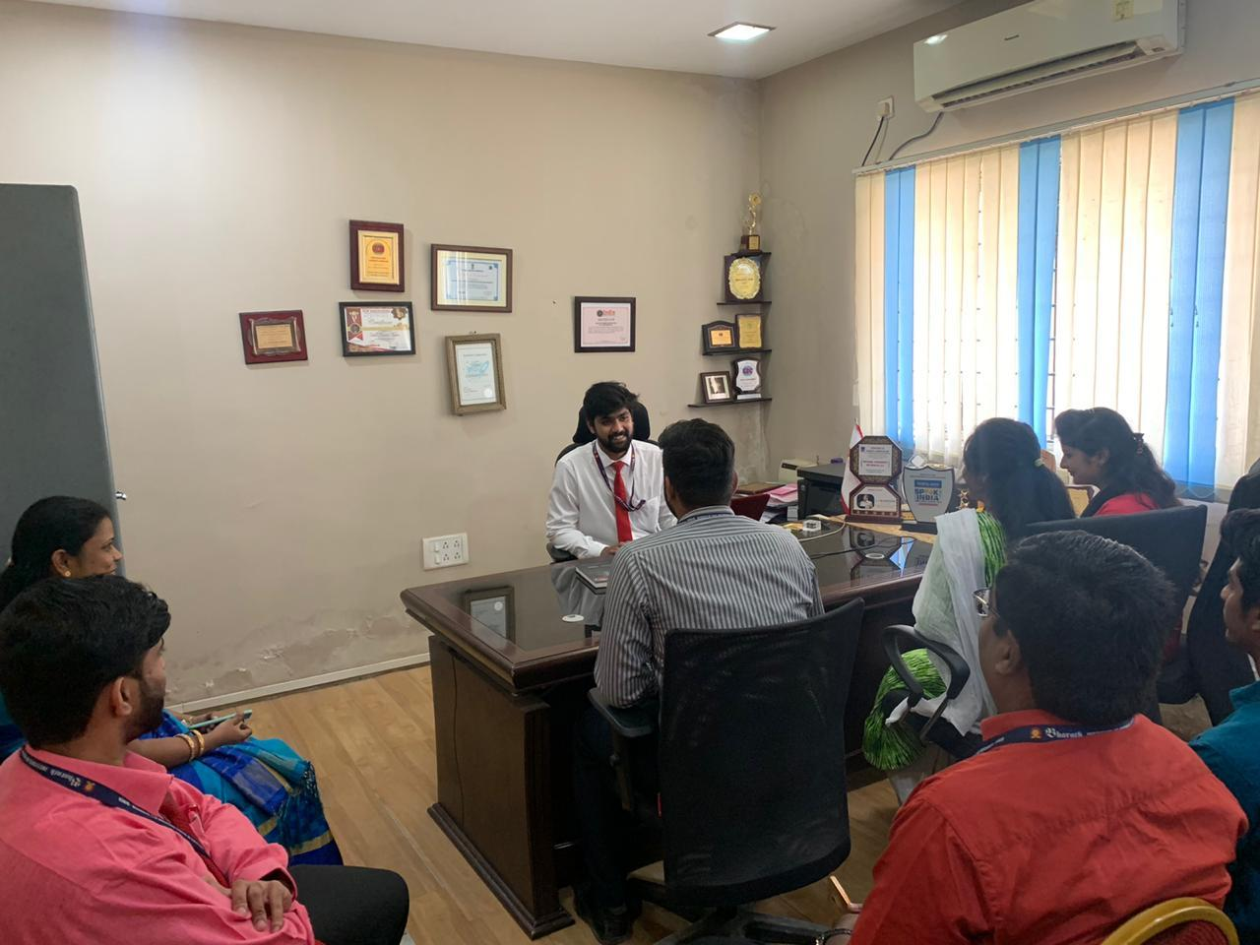
One Day HoD, Intra-Department Event

Slide 14
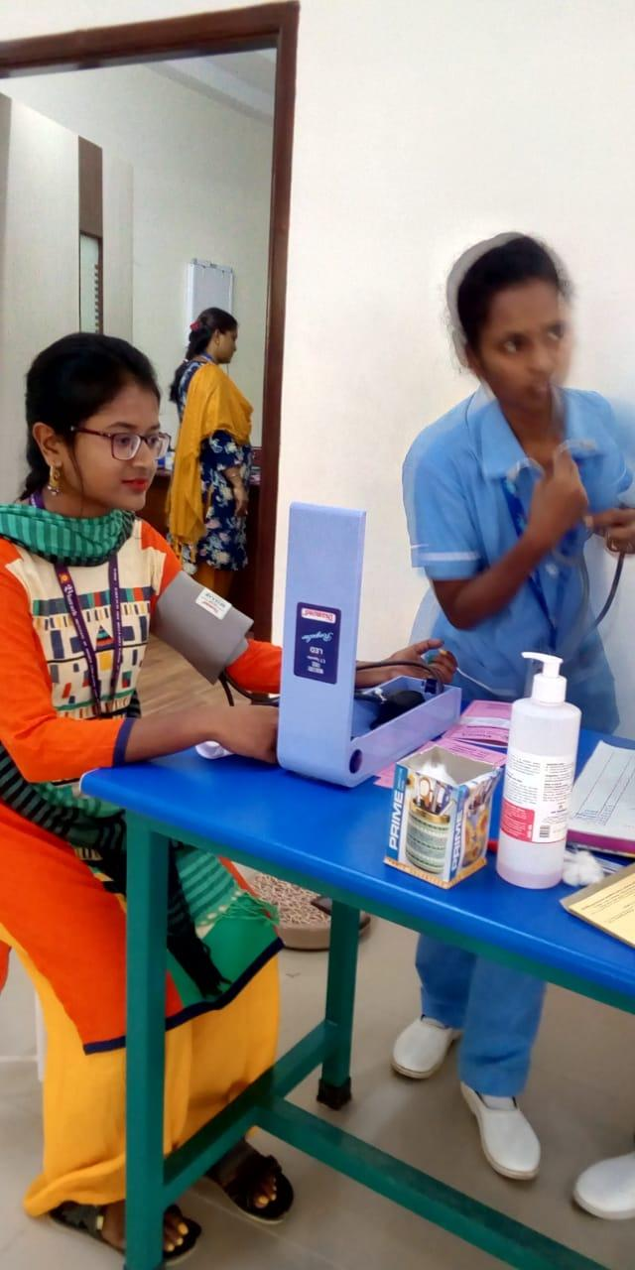
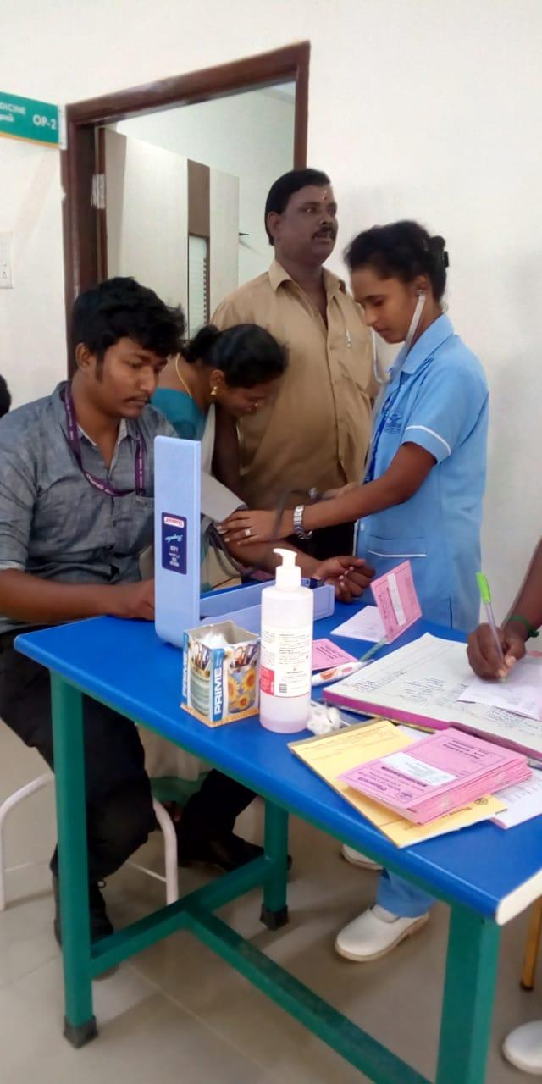
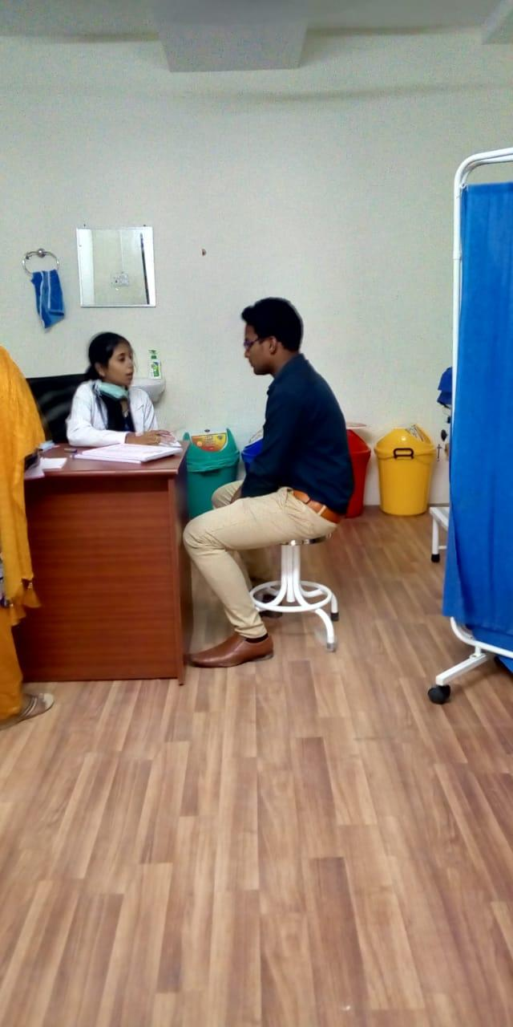
Medical Check Up in Bharath Hospital

Slide 15
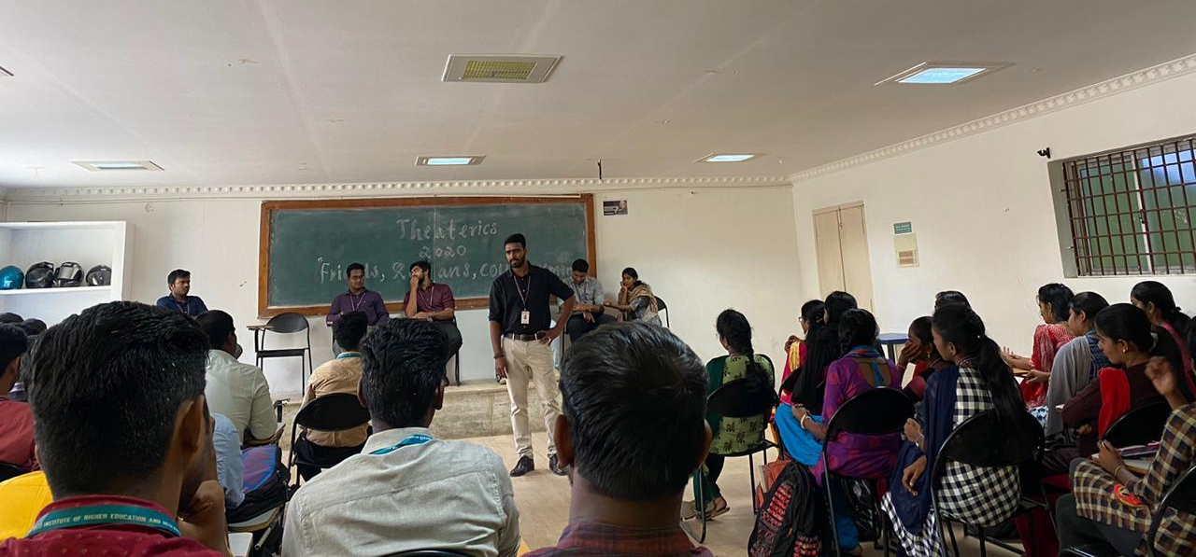
Theatrics – Intra Departmental Competition

Slide 16
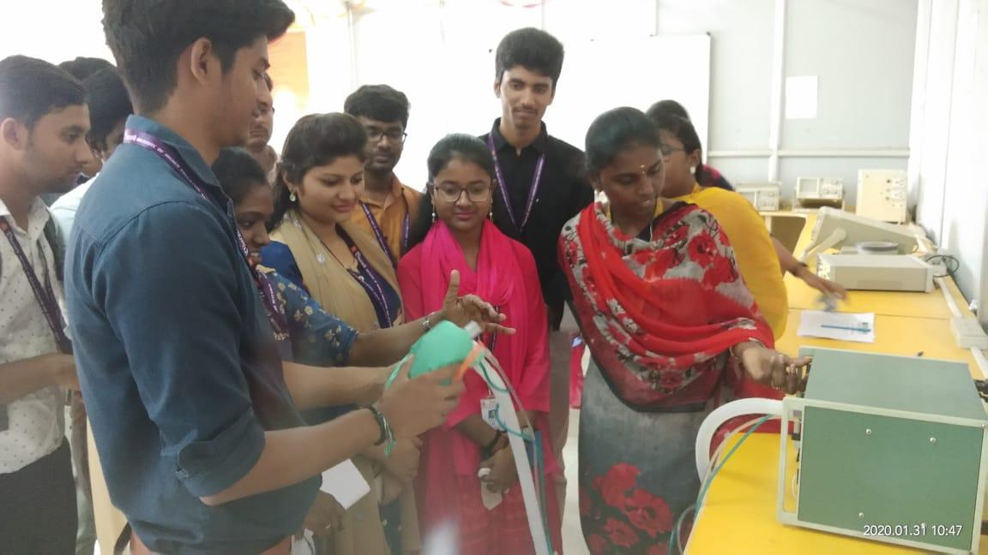
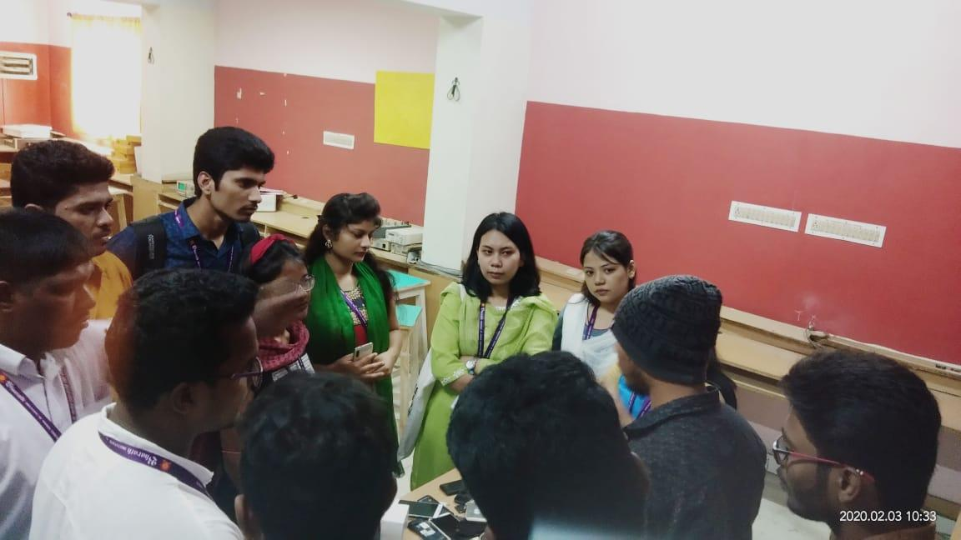
Technical Skills Training 30.1.20’ to 3.2.20’

Slide 17
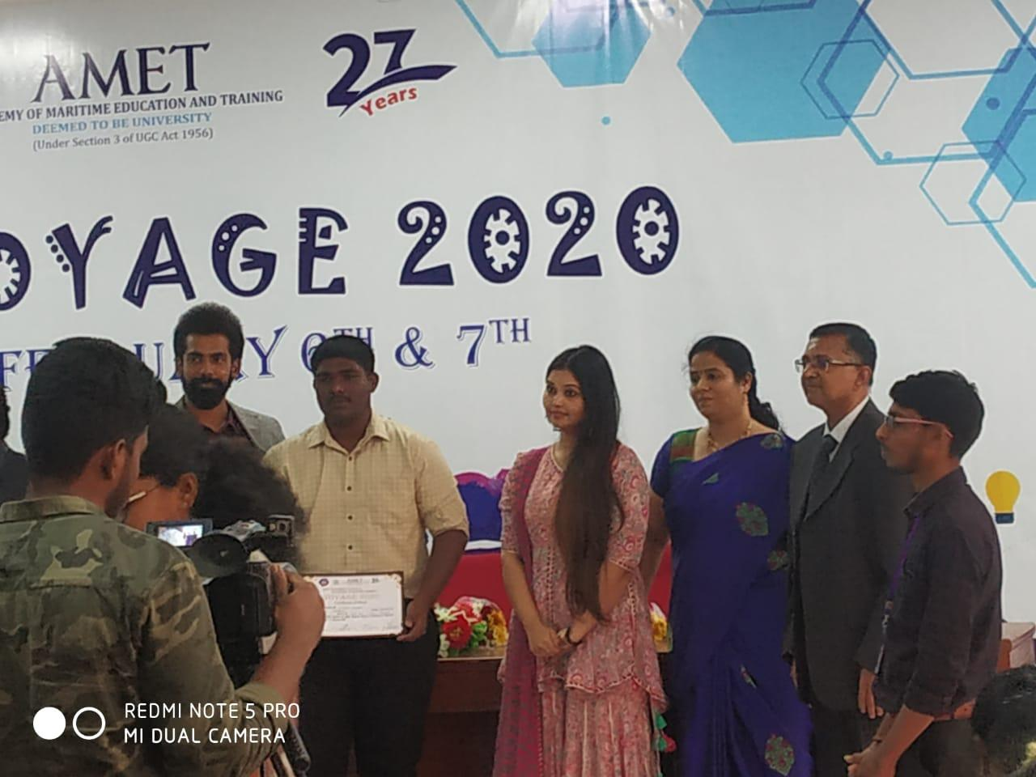
Mr. Antony Stijo, won the Second Place in the “Best Manager Event” at AMET University on 7.2.20’

Slide 18
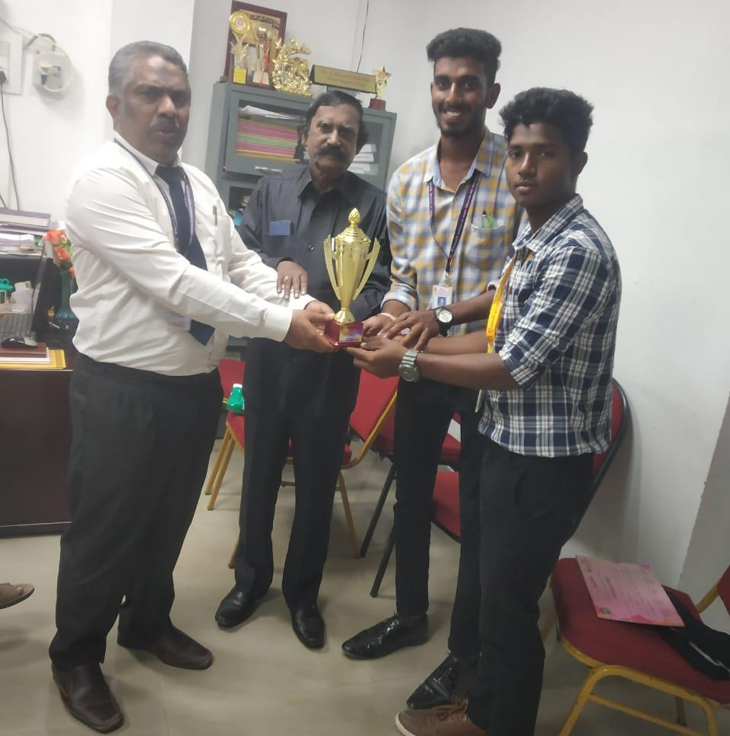
Winners in the Cricket 2020 Tournament

Slide 19
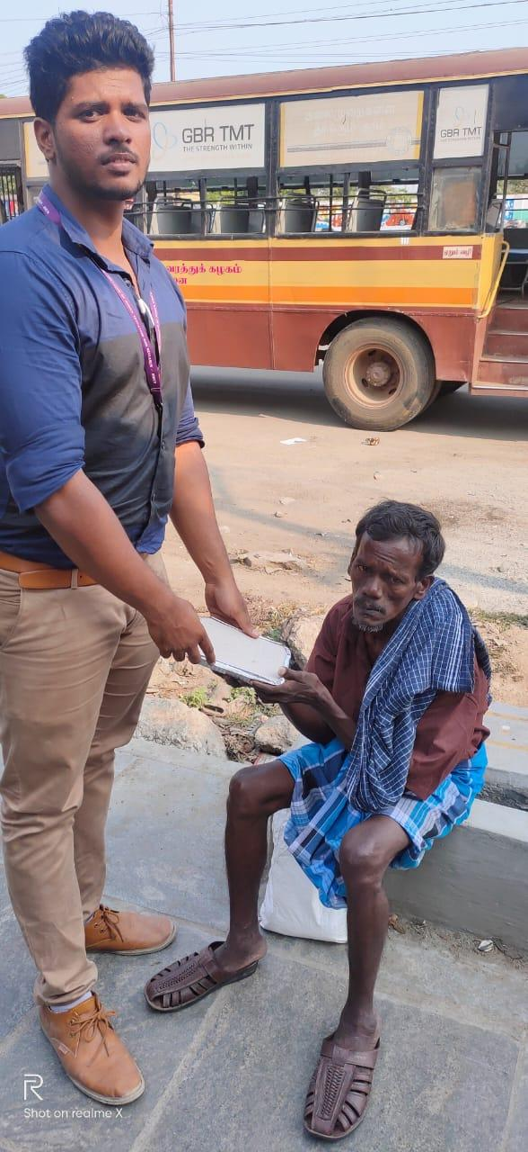
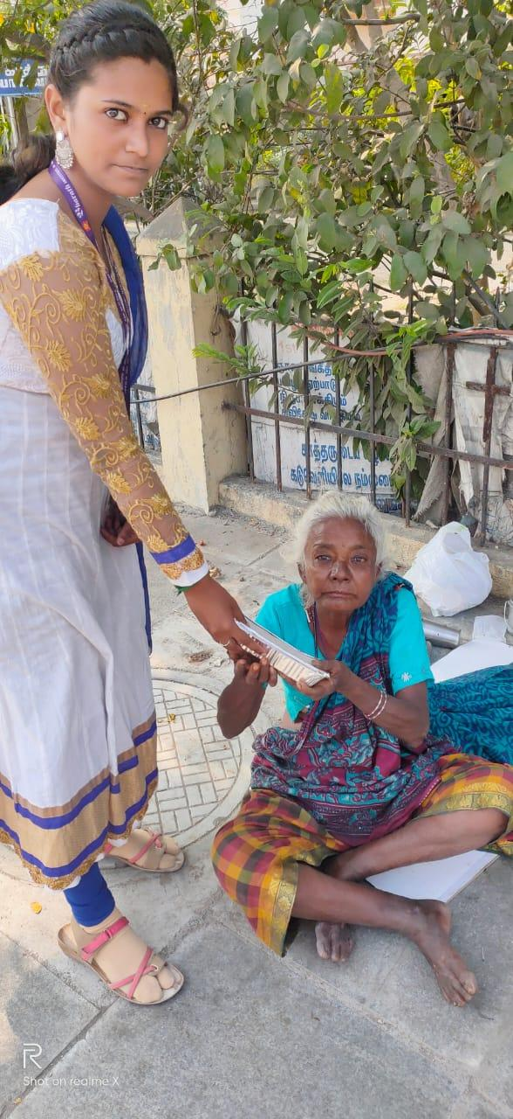
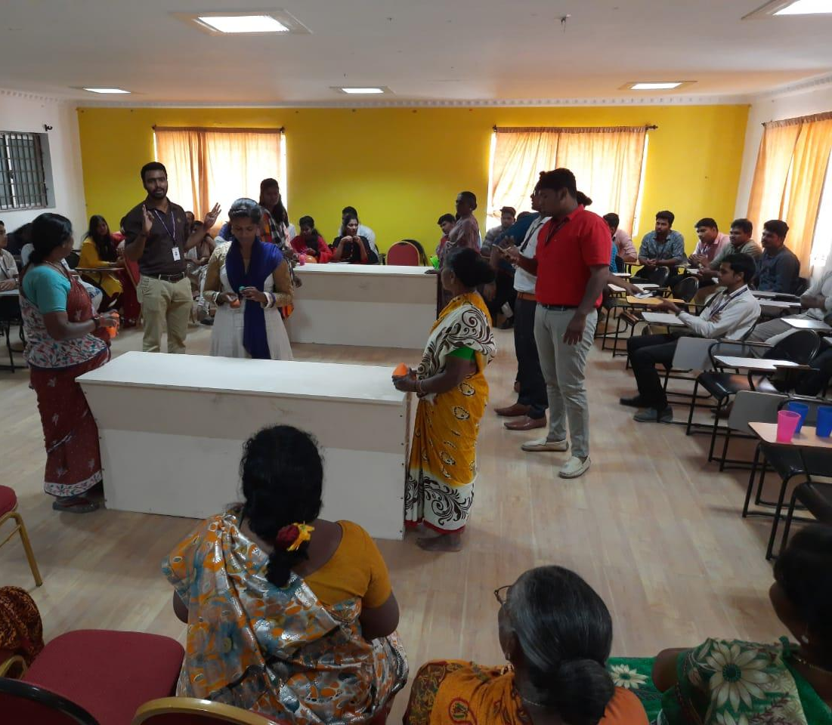
Valentines Day: Fall in Love with the Meek 14.2.20’

Slide 20
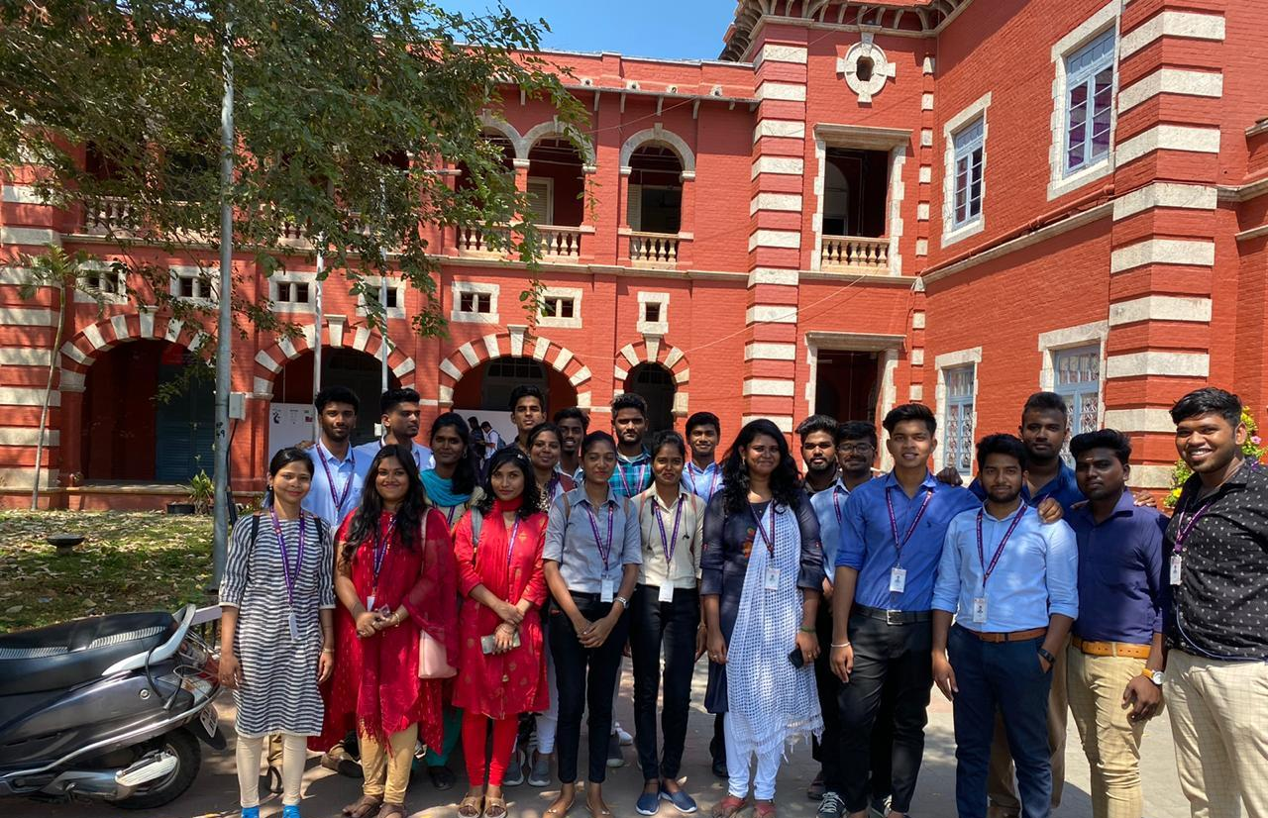
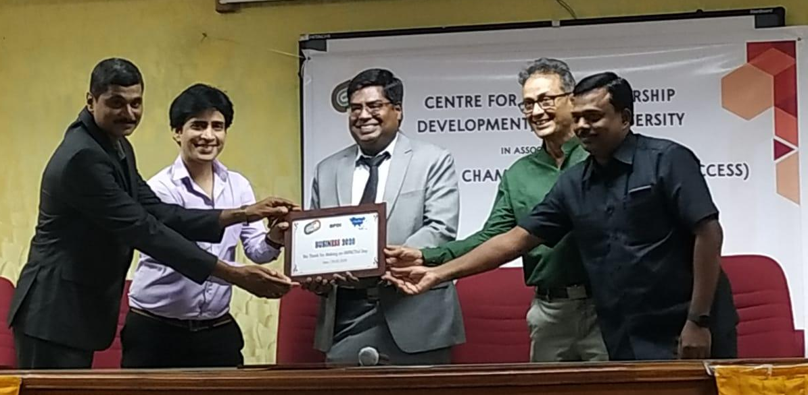
Entrepreneurship Summit by Indo-Asian Chamber of Commerce & Center for Entrepreneurship at Anna University, 20.02.20’

